Slide 1

Inisiatif ICT sektor awam
Institut Tadbiran Awam Negara (INTAN)
National Institute of Public Administration
Malaysia
“Memacu Transformasi Melalui Pembelajaran”

Slide 2
Kerajaan elektronik

Slide 3
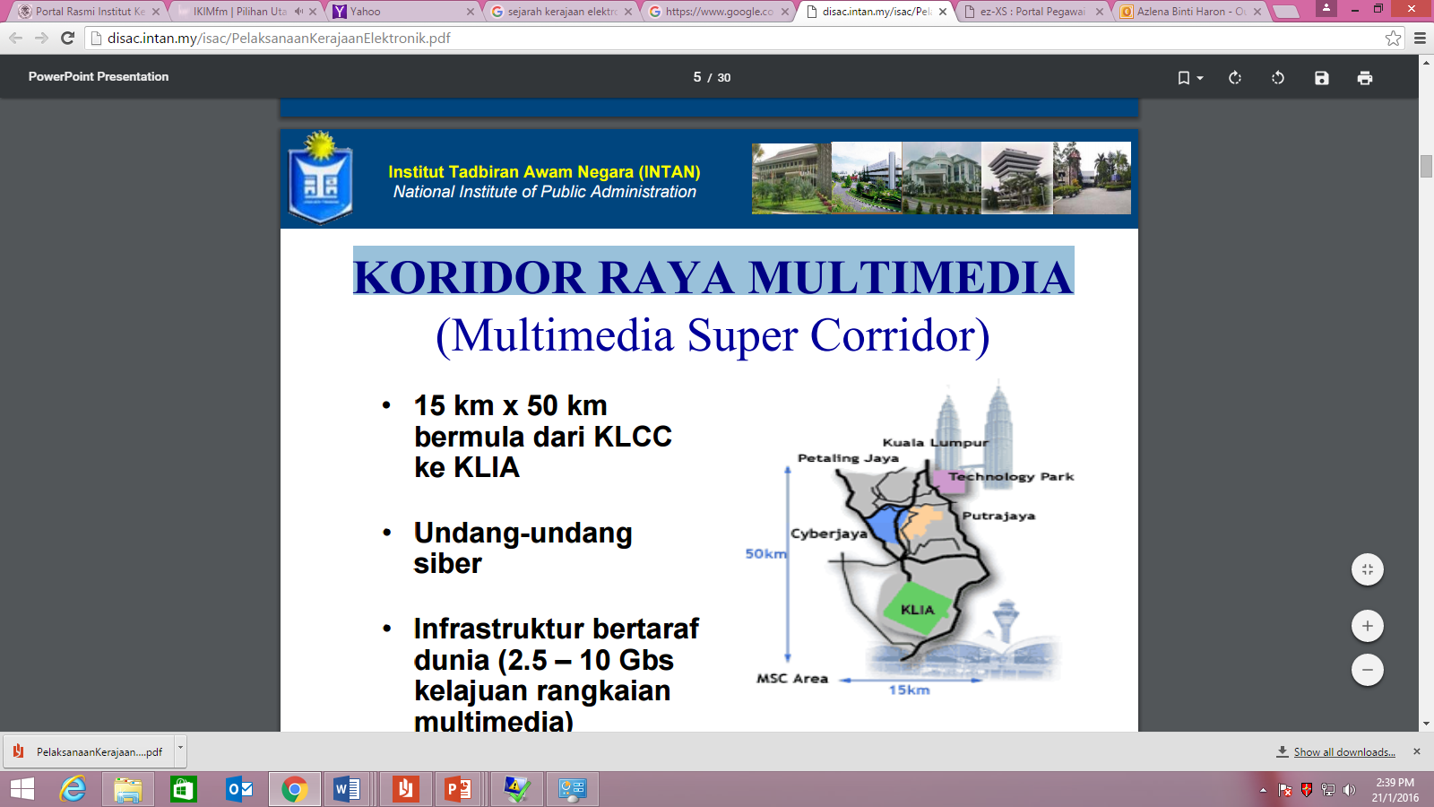
KORIDOR RAYA MULTIMEDIA (MSC)
15 km x 50 km bermula dari KLCC ke KLIA
Undang-undang siber • Infrastruktur bertaraf dunia (2.5 – 10 Gbs kelajuan rangkaian multimedia)
Undang-undang siber
Infrastruktur bertaraf dunia (2.5 – 10 Gbs kelajuan rangkaian multimedia)
MSC-1

Slide 4
OBJEKTIF MSC
Mencapai Wawasan 2020 dengan merangsang pertumbuhan produktiviti (productivity-led)
Untuk melonjakkan Malaysia sebagai pemimpin dalam Era Maklumat dengan menarik dan membangunkan syarikat bertaraf dunia melalui “perkongsian pintar” (smart partnerships)
Untuk membangunkan jambatan global di antara Malaysia dan bandaraya pintar bagi kepentingan bersama (global bridges)
MSC-2

Slide 5
7 APLIKASI PERDANA
1
Kerajaan Eletronik
2
Multipurpose Smart Card
3
Smart School
4
Telehealth
5
R&D Cluster
6
E-Business
7
Technoprenaur Development
EGOV1.0-2
Notes:
1. Kerajaan Elektronik
2. Multipurpose Smart Card
3. Smart School
4. Tele health
5. R&D Cluster
6. E-Business
7. Technoprenaur

Slide 6
7 PROJEK PERINTIS EGOV
1
E-Services
2
E-Procurement
3
GOE
4
HRMIS
5
PMS
6
ELX
7
E-Syariah
EGOV1.0-3
Notes:
E-Services
E-Procurement
GOE
HRMIS
PMS
ELX
E-Syariah

Slide 7
Challenges
Information Privacy & Security
Reengineering and Streamlining of Current Processes and Procedures
Managing Diverse Technologies & Obsolescence
Integration & Interoperability of EG with other Flagship Applications & Legacy Systems
Human Resource Implication
•Education, training & Accessibility
EGOV1.0-4

Slide 8
Critical Success Factor
Administrative Mechanism
Legal Framework
Telecommunication Infrastructure
Other Initiatives
EGOV1.0-5

Slide 9
inisiatif kerajaan

Slide 10
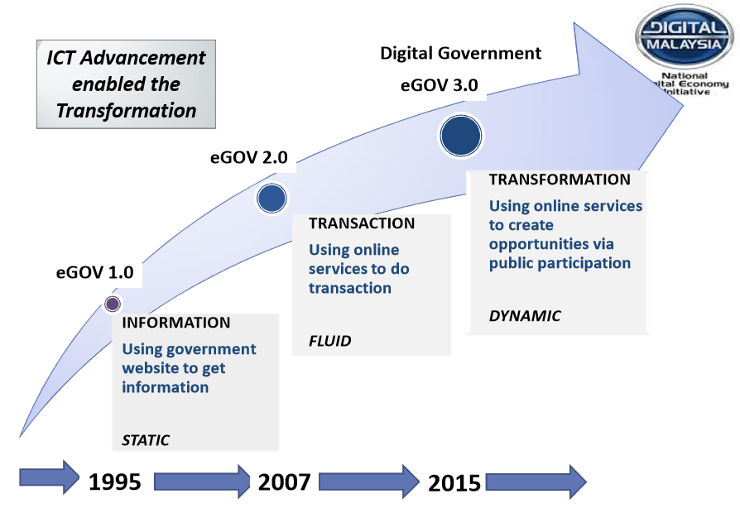
Public Sector ICT Journey
Notes:
eGov 1.0

Slide 11
Public Sector ICT Directions

Slide 12
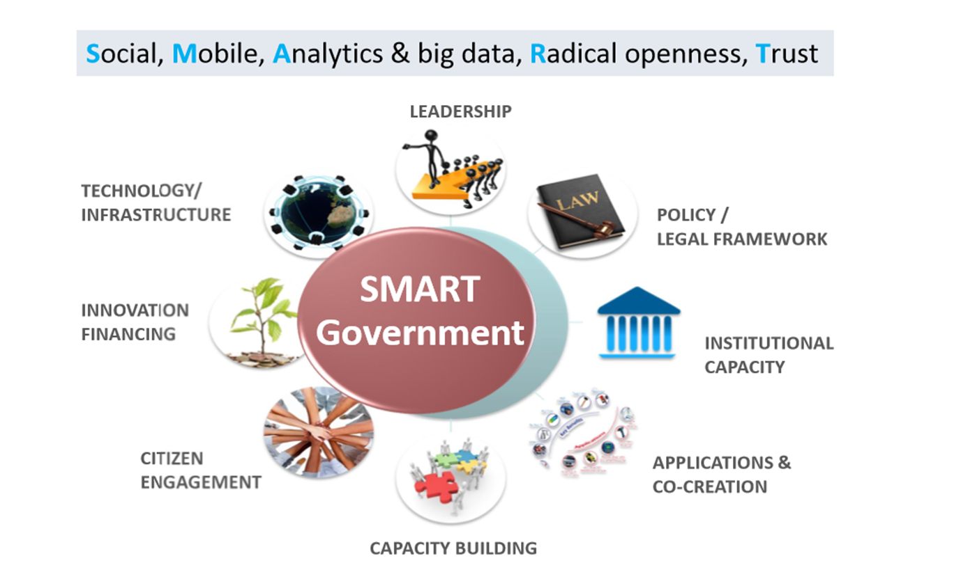
SMART Government Model

Slide 13
Public Sector Initiatives : Leveraging Nexus of Forces for Agility in Service Delivery
Agency presence in portal, websites & social media
MyEmail
1GovUC
1. mySMS
2. Mobile web
3. Mobile apps
Social
Mobile
Information
Cloud
Service Intelligence
DDMS
myGovernment Portal
myMesyuarat
Big Data Analytics (BDA)
1. 1Gov*Net
2. GDC
3. MyGRiC
4. MTSA
5. ISMS
6. MyGSOC
7. My1Login

Slide 14
Media sosial

Slide 15
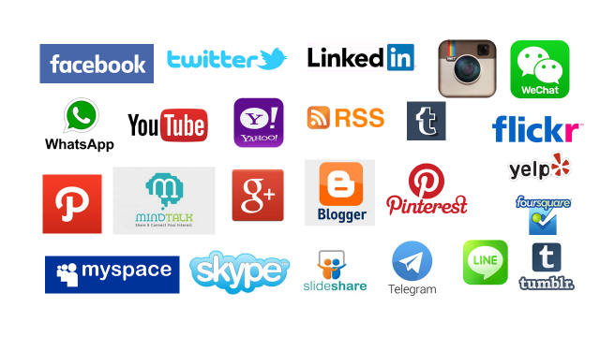
Apakah Media Sosial?
Media sosial merujuk kepada sejenis saluran komunikasi dalam talian yang membolehkan pengguna berinteraksi dengan mudah secara bebas, berkongsi dan membincangkan maklumat dengan menggunakan gabungan multimedia yang terdiri daripada teks, gambar, video dan audio.

Slide 16






Social Media Benefits
SHARE
Share services, products & brands
Own up if we make mistakes
OWN
COLLABORATE
Collaborate with others
Interact with
people
INTERACT
AVAILABLE
LISTEN
Listen to people’s
views & critics
24 hours X 365 days
Notes:
S - SHARE services, products & brands
O - OWN up if we make mistakes
C - COLLABORATE with others
I - INTERACT with people & be INTERESTING to get INSIGHTS
A - Be AVAILABLE
L - LISTEN to people’s views & critics

Slide 17

Etika Penggunaan Media Sosial Sektor Awam

Slide 18
Government mobility

Slide 19
Mobile
Primary computing platform
Easy to get and use devise
Easy to stay connected with people
Easy to switch between work and non-work info

Slide 20
Mobile Tech : Continue to dominate the world
Understand netizen better and respond to their needs more rapidly.
Compete and be relevant.
Mobile apps are becoming more mainstream.
New technology increase productivity and support better decision making.
More options for meeting the changing needs of our employees – through virtual teams, flexible work arrangements.
Learning is becoming social and can happen anywhere and at anytime.

Slide 21
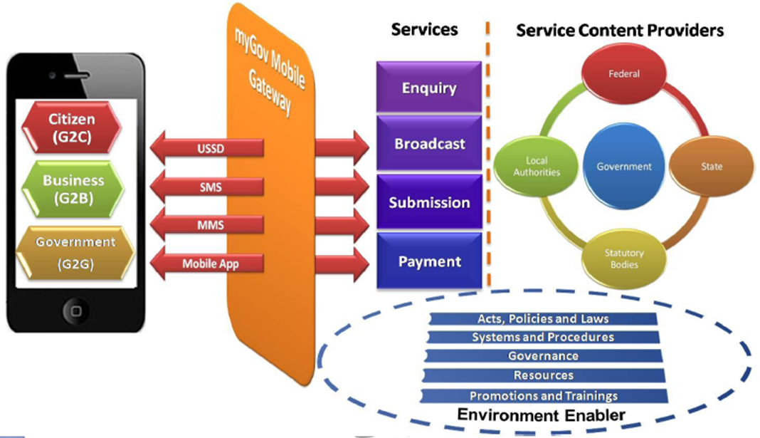
MyGov Mobile Model Overview
Source : MAMPU

Slide 22
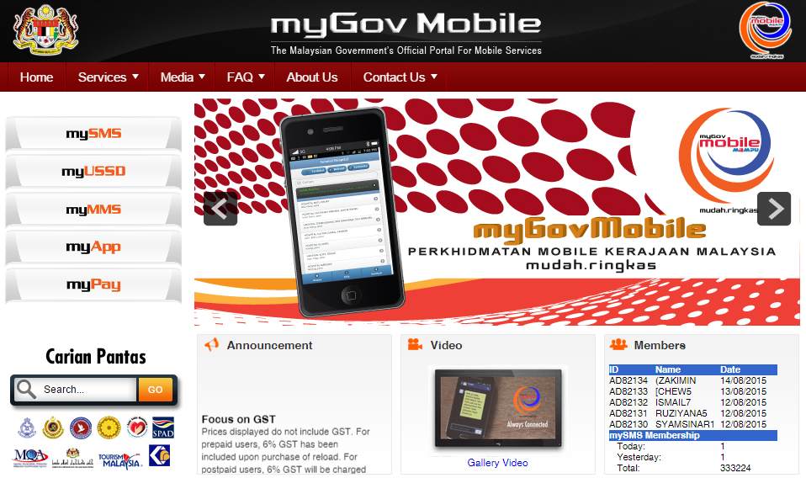
MyGov Mobile

Slide 23
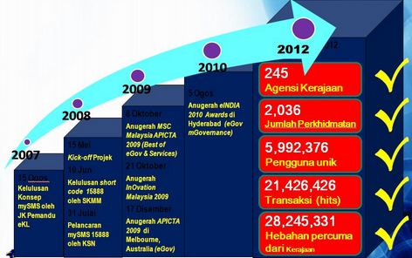
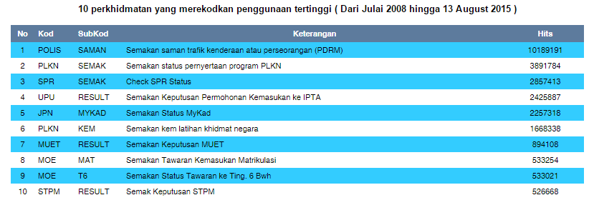
mySMS Services
mySMS Milestone

Slide 24
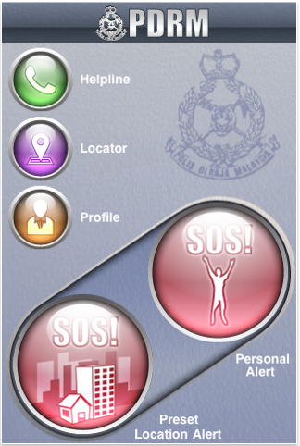

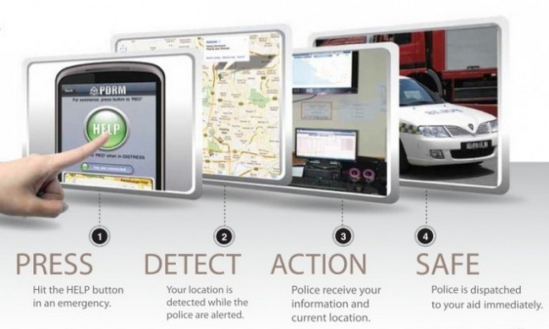
MyDistress App : A SMART TECHNOLOGY FOR A SAFER YOU
Connects you directly to the police
for emergency alerts “just with clicks”
Download on:
App store, Google Play,
Blackberry, Marketplace, Symbian (J2ME)

Slide 25









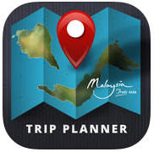




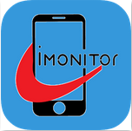
Examples of Government Mobile Apps
myHealth
myMahtas
myJPS
myKPDNKK
myCuaca
myJakim
mySPAD
myHRMIS Cuti
myFoodSafe
Malaysia
Trip Planner
myJPN
NRE Malaysia
Eco-Park
1MOCC@Labuan
iMonitor
Source : Gallery of Malaysian Government Mobile Applications (GAMMA)
gamma.malaysia.gov.my
Notes:
Gamma.malaysia.gov.my

Slide 26
Big data

Slide 27
Big Data
Big Data is high-volume, high-variety and high-velocity information assets that demand cost-effective, innovative forms of information processing for enhanced insights and decision making.
VOLUME – large volume data
VARIETY – wide range of data (text, audio, images, video)
VELOCITY – time sensitive data (rapid creation of new data)
Volume + Variety + Velocity = Value
Source : Gartner

Slide 28
Big Data Analytics (BDA)
Big Data Analytics (BDA) is the process of examining large amounts of data of a variety of types (big data) to uncover hidden patterns, unknown correlations and other useful information.
Source : WhatIs.com

Slide 29
Big Data Analytics (BDA)
Large
BDA is used to produce actionable information
for better accuracy in decision making
Volume, Velocity, Variety of Data
Predictive Analytics Accuracy
As the volume, velocity, and variety of data increases so does the ability to create more
accurate and complex BI; small amount of data
can be used for descriptive analytics while
larger amount of data can be suitable for
more predictive analytics
Small
Complexity of Analytics
Descriptive
Predictive
Source : Gendron (2014). Business Intelligence and the Cloud.

Slide 30
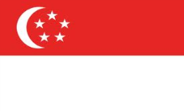
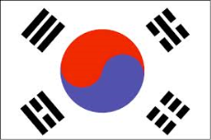
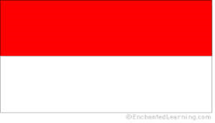



Big Data Around the Globe
Singapore Government uses Big Data analytics to optimise transport management
South Korea Government improves citizen engagement through Open Data & Big Data
Indonesian capital city prioritises Big Data and Open Government for public safety and transport
UK government to invest US$120 million on Big Data
Big data analytics cuts energy cost for US Defence
Big data to deliver NZ Budget shake-up

Slide 31
BDA National Benefits
Contribute to National Digital Economy
48% ICT services in 2020 to contribute 17% GDP
Lead by Digital Malaysia
Enhance service delivery to citizen and business
Transform service quality
Improve organisational productivity
Improve customer services
Motivate employees
Improve multi-lateral Cooperation among ASEAN countries through BDA
Source : MAMPU. (2014). “Public Sector Big Data Analytics Initiative : Malaysia’s Perspective”
Presentation slides : 3rd ASEAN CIO Forum 2014

Slide 32
BDA National Challenges & Focus Area
Challenges :
Define and understand the benefit to organizations
Integrate legacy systems with big data technology
Lack of big data skills
Data privacy, governance and compliance issues
Expensive cost of big data tools
3 Focus Areas :
Proliferate usage of BDA in all sectors
Catalyse adoption and usage of BDA in public sector
Build the BDA industry in Malaysia
Notes:
3 Focus Areas :
Short term (1-2 years)
Kick start BDA priorities
Framework
Pilot government projects
Private sector projects
Medium Term (3-4 years)
Grow use of BDA
Build stron talent and skillsets in BDA
Building sustainable National BDA initiative
Long Term (5-7 years)
Public – Private BDA initiatives
Leadership in BDA
Widespread use of BDA

Slide 33
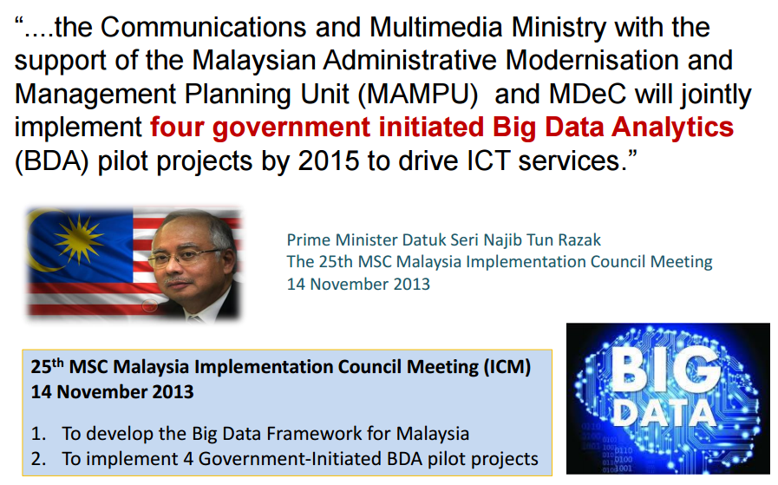
Big Data Implementation Mandate
Source : MAMPU

Slide 34
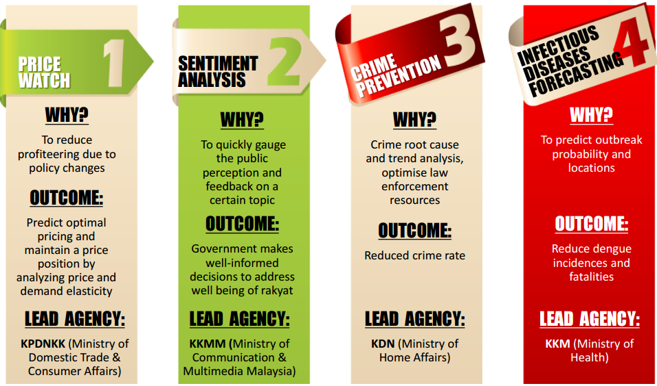
Big Data Pilot Projects
Source : MAMPU

Slide 35
Leveraging Big Data Analytics

Slide 36
open data

Slide 37
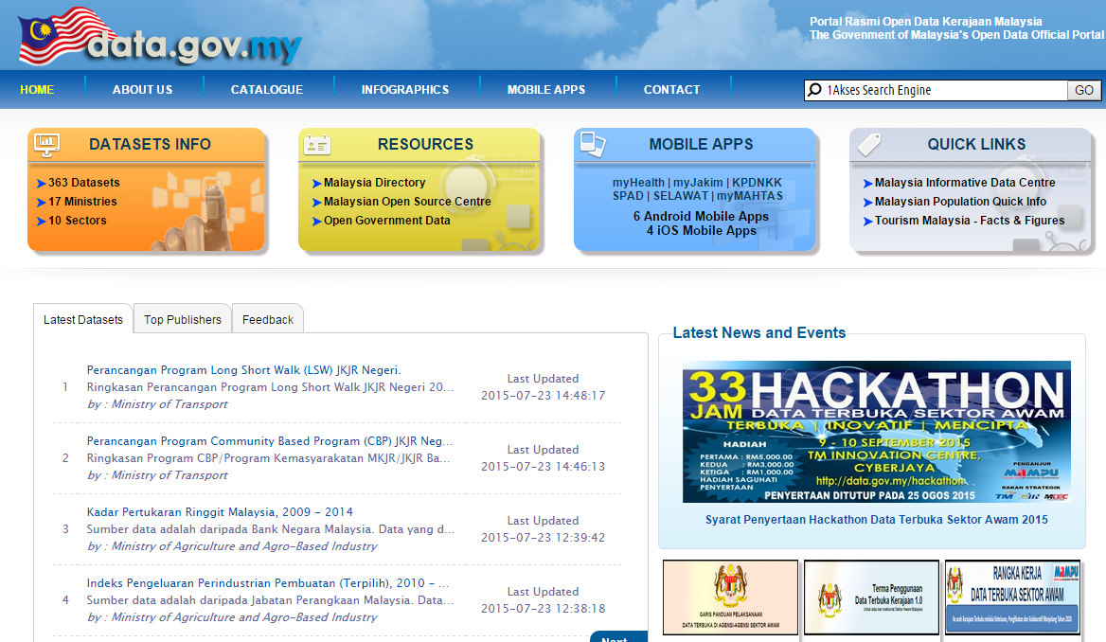
Open Data
Can be freely used, reused and redistributed by anyone. Benefitted by entrepreneurs, researchers, educationist & many types of industries.

Slide 38
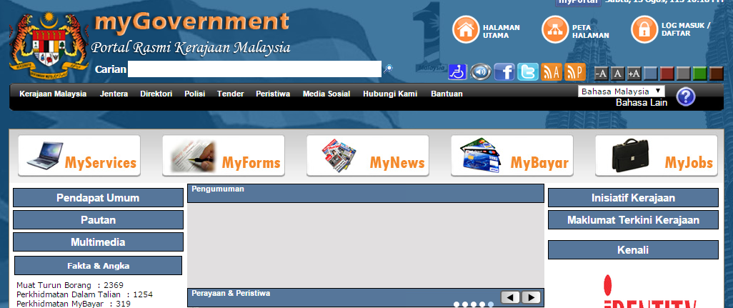
myGovernment Portal
MyGovernment Portal as Single Window Government especially on Government online services
Services :
Information of Malaysia Government
Downloadable forms
Submission forms
Online payment

Slide 39
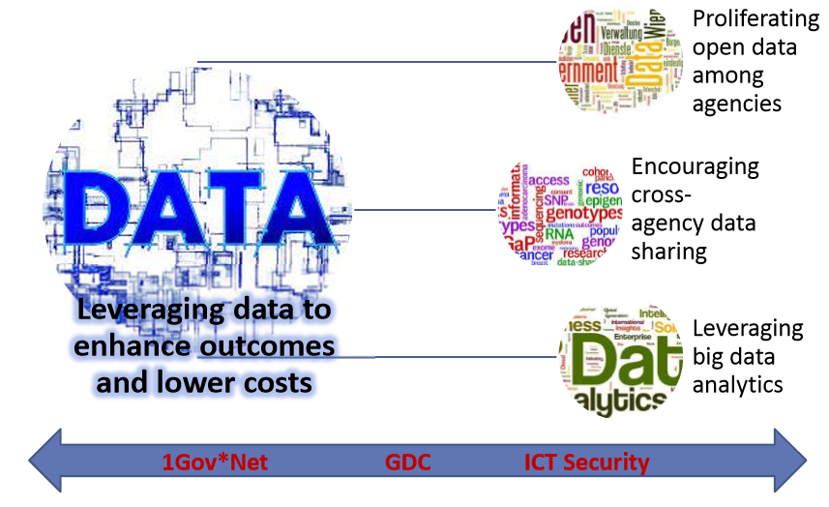
Enhance service delivery with citizens at the centre

Slide 40
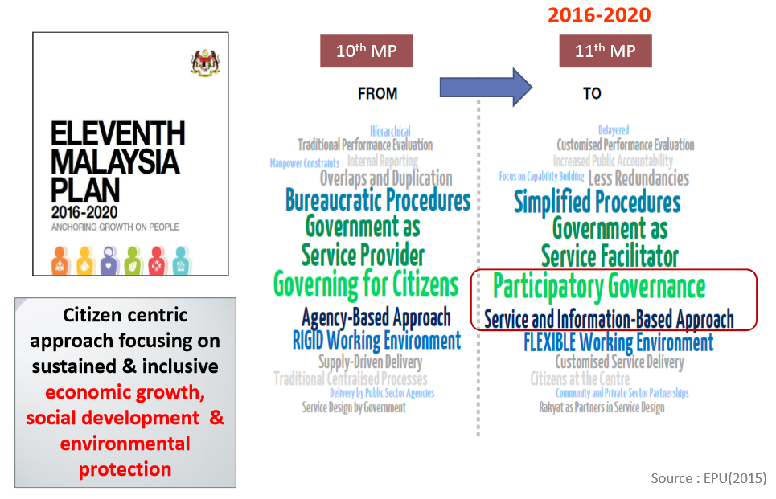
Citizen Centric

Slide 41
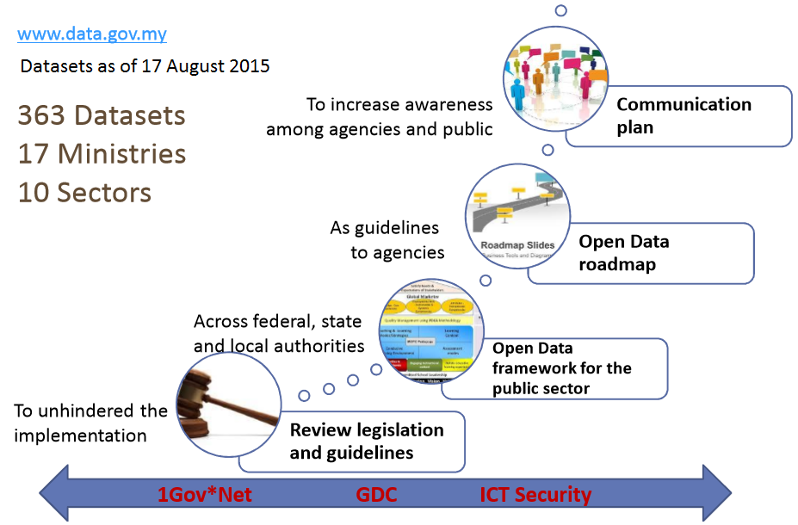
Proliferating open data among agencies

Slide 42
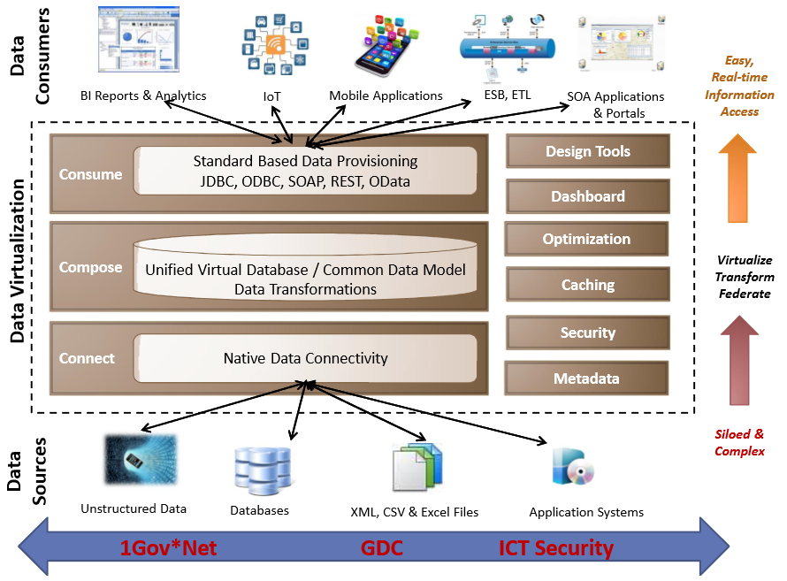
Encouraging Cross Agency Data Sharing

